Slide 1

Natural Language Processing
Naeemullah Khan
naeemullah.khan@kaust.edu.sa
KAUST Academy
King Abdullah University of Science and Technology

Slide 2
Natural Language Processing
Naeemullah Khan
naeemullah.khan@kaust.edu.sa
KAUST Academy
King Abdullah University of Science and Technology

Slide 3


Sequence to sequence models
Seq2seq
I ate an apple
I ate an apple Ich habe einen apfel gegessen
Seq2seq
Sequence goes in, sequence comes out
No notion of “time synchrony” between input and output
  May even not even maintain order of symbols
    E.g. “I ate an apple” → “Ich habe einen apfel gegessen”
v
  Or even seem related to the input
    E.g. “My screen is blank” → “Please check if your computer is plugged in.”
3
KAUST Academy
Natural Language Processing
3

Slide 4
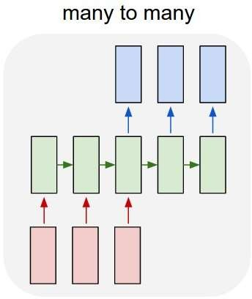
Modelling the problem
Delayed sequence to sequence
4
KAUST Academy
Natural Language Processing
4

Slide 5
Modelling the problem
First process the input and generate a hidden representation for it
Delayed sequence to sequence
5
KAUST Academy
Natural Language Processing
5

Slide 6
Modelling the problem
First process the input and generate a hidden representation for it
Then use it to generate an output
Delayed sequence to sequence
6
KAUST Academy
Natural Language Processing
6

Slide 7
Modelling the problem
First process the input and generate a hidden representation for it
Then use it to generate an output
Problem: Each word that is output depends only on current hidden state, and not on previous outputs
7
KAUST Academy
Natural Language Processing
7

Slide 8
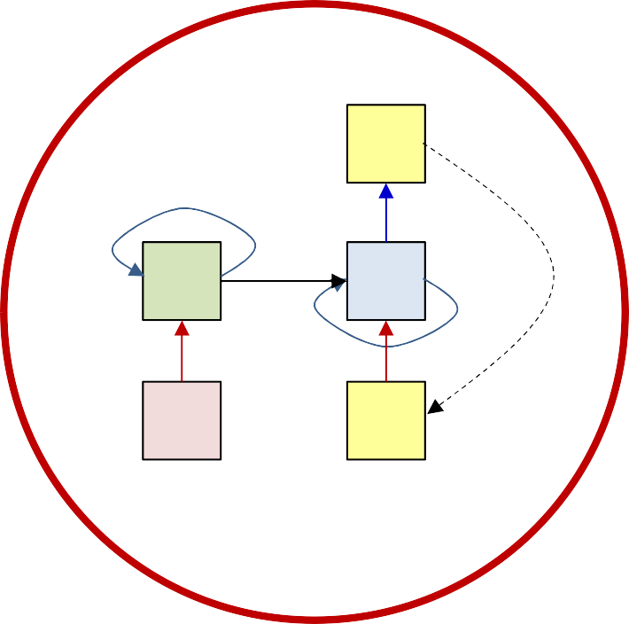
Modelling the problem
Delayed sequence to sequence
– Delayed self-referencing sequence-to-sequence
8
KAUST Academy
Natural Language Processing
8

Slide 9
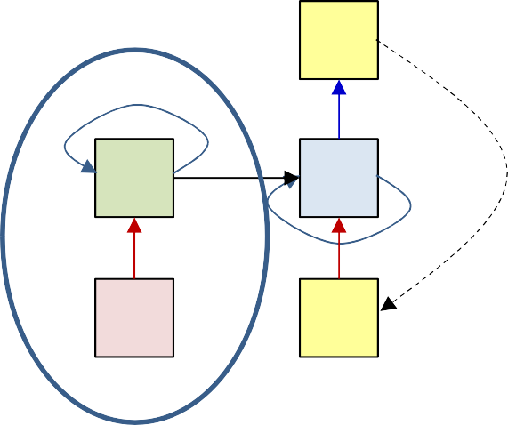
The “simple” translation model
I ate an
apple <eos>
The input sequence feeds into a recurrent structure
The input sequence is terminated by an explicit <eos> symbol
– The hidden activation at the <eos> “stores” all information about the sentence
9
KAUST Academy
Natural Language Processing
9

Slide 10
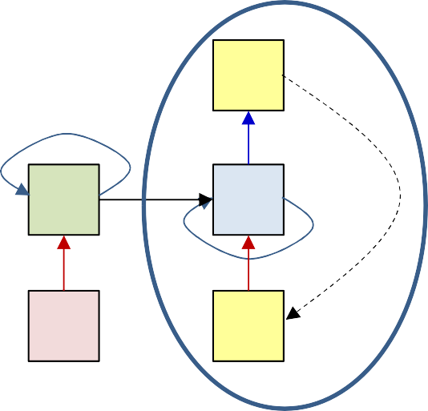
The “simple” translation model
I ate an
apple <eos>
The input sequence feeds into a recurrent structure
The input sequence is terminated by an explicit <eos> symbol
  The hidden activation at the <eos> “stores” all information about the sentence
Subsequently a second RNN uses the hidden activation as initial state, and
<sos> as initial symbol, to produce a sequence of outputs
  The output at each time becomes the input at the next time
  Output production continues until an <eos> is produced
10
KAUST Academy
Natural Language Processing
10

Slide 11
The “simple” translation model
Ich
I ate an
apple <eos> <sos>
The input sequence feeds into a recurrent structure
The input sequence is terminated by an explicit <eos> symbol
– The hidden activation at the <eos> “stores” all information about the sentence
•
Subsequently a second RNN uses the hidden activation as initial state to
produce a sequence of outputs
–
–
The output at each time becomes the input at the next time
Output production continues until an <eos> is produced
10
KAUST Academy
Natural Language Processing
11

Slide 12
The “simple” translation model
Ich habe
I ate an
apple <eos> <sos>
Ich
The input sequence feeds into a recurrent structure
The input sequence is terminated by an explicit <eos> symbol
– The hidden activation at the <eos> “stores” all information about the sentence
•
Subsequently a second RNN uses the hidden activation as initial state to
produce a sequence of outputs
–
–
The output at each time becomes the input at the next time
Output production continues until an <eos> is produced
KAUST Academy
Natural Language Processing
12

Slide 13
The “simple” translation model
Ich habe einen
I ate an
apple <eos> <sos>
Ich habe
The input sequence feeds into a recurrent structure
The input sequence is terminated by an explicit <eos> symbol
– The hidden activation at the <eos> “stores” all information about the sentence
•
Subsequently a second RNN uses the hidden activation as initial state to
produce a sequence of outputs
–
–
The output at each time becomes the input at the next time
Output production continues until an <eos> is produced
KAUST Academy
Natural Language Processing
13

Slide 14
The “simple” translation model
Ich habe einen apfel gegessen <eos>
I ate an
apple <eos> <sos>
Ich habe einen apfel
gegessen
The input sequence feeds into a recurrent structure
The input sequence is terminated by an explicit <eos> symbol
– The hidden activation at the <eos> “stores” all information about the sentence
•
Subsequently a second RNN uses the hidden activation as initial state to
produce a sequence of outputs
–
–
The output at each time becomes the input at the next time
Output production continues until an <eos> is produced
KAUST Academy
Natural Language Processing
14

Slide 15
The “simple” translation model
ENCODER
Ich habe einen apfel gegessen <eos>
I ate an
apple <eos> <sos>
Ich habe
einen apfel gegessen
DECODER
The recurrent structure that extracts the hidden representation from the input sequence is the encoder
The recurrent structure that utilizes this representation to produce the output sequence is the decoder
KAUST Academy
Natural Language Processing
15

Slide 16
A problem with this framework
Ich habe einen apfel gegessen <eos>
0 1 2 3 4 5
I ate an apple <eos> <sos> Ich habe einen apfel gegessen
All the information about the input sequence is embedded into a single vector
  The “hidden” node layer at the end of the input sequence
  This one node is “overloaded” with information
    Particularly if the input is long
KAUST Academy
Natural Language Processing
16

Slide 17
A problem with this framework
I ate an
apple <eos>
In reality: All hidden values carry information
– Some of which may be diluted by the time we get to the final state of the encoder
KAUST Academy
Natural Language Processing
17

Slide 18
A problem with this framework
Ich habe einen apfel gegessen <eos>
I ate an apple <eos> <sos> Ich habe
In reality: All hidden values carry information
einen
apfel
gegessen
– Some of which may be diluted by the time we get to the final state of the encoder
Every output is related to the input directly
  Not sufficient to have the encoder hidden state to only the initial state of the decoder
  Misses the direct relation of the outputs to the inputs
KAUST Academy
Natural Language Processing
18

Slide 19





Using all input hidden states
Ich habe einen apfel gegessen <eos>
1
Average =
N
i
N
i
<sos>
Ich habe
einen
apfel
gegessen
I ate an
apple <eos>
Simple solution: Compute the average of all encoder hidden states
Input this average to every stage of the decoder
The initial decoder hidden state is now separate from the encoder
– And may be a learnable parameter
KAUST Academy
Natural Language Processing
19

Slide 20
Using all input hidden states
Ich habe einen apfel gegessen <eos>
1
Average =
N
i
N
i
<sos>
Ich habe
einen
apfel gegessen
I ate an
apple <eos>
Problem: The average applies the same weight to every input
It supplies the same average to every output word
In practice, different outputs may be related to different inputs
– E.g. “Ich” is most related to “I”, and “habe” and “gegessen” are both most related to “ate”
KAUST Academy
Natural Language Processing
20

Slide 21

Using all input hidden states
Ich habe einen apfel gegessen <eos>
0
1
2
3
4
5
I ate an
apple <eos>
<sos> Ich habe einen apfel gegessen
Solution: Use a different weighted average for each output word
– The weighted average provided for the kth output word is:
N
t i i
i
20
KAUST Academy
Natural Language Processing
21

Slide 22

Using all input hidden states
Ich
0
–1
0
1
2
3
4
I ate an
apple <eos>
<sos>
Solution: Use a different weighted average for each output word
– The weighted average provided for the kth output word is:
N
0
i
i
i
21
KAUST Academy
Natural Language Processing
22

Slide 23
Using all input hidden states
Ich habe
1
0
–1
0
1
2
3
4
I ate an
apple <eos>
<sos> Ich
Solution: Use a different weighted average for each output word
– The weighted average provided for the kth output word is:
N
1
i
i
i
22
KAUST Academy
Natural Language Processing
23

Slide 24
Using all input hidden states
Ich habe einen
2
0
1
–1
0
1
2
3
4
I ate an
apple <eos>
<sos> Ich habe
Solution: Use a different weighted average for each output word
– The weighted average provided for the kth output word is:
N
2
i
i
i
23
KAUST Academy
Natural Language Processing
24

Slide 25
Using all input hidden states
Ich habe einen apfel
3
0
1
2
–1
0
1
2
3
4
I ate an
apple <eos>
<sos> Ich habe einen
Solution: Use a different weighted average for each output word
– The weighted average provided for the kth output word is:
N
3
i
i
i
24
KAUST Academy
Natural Language Processing
25

Slide 26
Using all input hidden states
Ich habe einen apfel gegessen
4
0
1
2
3
–1
0
1
2
3
4
I ate an
apple <eos>
<sos> Ich habe einen apfel
Solution: Use a different weighted average for each output word
– The weighted average provided for the kth output word is:
N
4
i
i
i
25
KAUST Academy
Natural Language Processing
26

Slide 27
Using all input hidden states
Ich habe einen apfel gegessen <eos>
5
0
1
2
3
–1
0
1
2
3
4
4
I ate an
apple <eos>
<sos> Ich habe einen apfel gegessen
Solution: Use a different weighted average for each output word
– The weighted average provided for the kth output word is:
N
5
i
i
i
26
KAUST Academy
Natural Language Processing
27

Slide 28


Using all input hidden states
Ich habe einen apfel gegessen <eos>
1 2 3 4 5
0
–1
0
1
2
3
4
I ate an
apple <eos>
<sos>
Ich habe
einen
apfel
gegessen
N
t
i i
i
_{ki} can somehow be made to “focus” on the
This solution will work if the weights right input word
– E.g., when predicting the word “apfel”, 𝑤₃(4), the weight for “apple” must be high while the rest must be low
How do we generate such weights??
27
KAUST Academy
Natural Language Processing
28

Slide 29

Attention Models
Ich habe einen apfel
4 5
gegessen <eos>
0
1
2 3
–1
0
1
2
3
4
5
–1
0
1
2
3
4
I ate an
apple <eos>
<sos>
Ich habe
einen
apfel
gegessen
N
t
i i
i
Attention weights: The weights are dynamically computed as functions of decoder state
i
– Expectation: if the model is well-trained, this will automatically “highlight” the correct input
But how are these computed?
KAUST Academy
Natural Language Processing
29

Slide 30

Attention weights at time
Ich habe einen
1
N
𝑐_{t} = _{𝑁} Σ 𝑤_{i}(𝑡)ℎ_{i}
i
3
–1
0
1
2
–1
0
1
2
3
4
I ate an
apple <eos>
<sos> Ich habe einen
must be computed from available
The “attention” weights information at time
i
at time
The primary information is _{t–1} (the state at time time
– Also, the input word at time 𝑡, but generally not used for simplicity
)
i
i t–1
KAUST Academy
Natural Language Processing
30

Slide 31



Requirement on attention weights
3
Ich habe einen
N
i
i
i
i
–1
0
1
2
i
Sum to 1.0
–1
0
1
2
3
4
<sos> Ich habe
einen
I ate an
The weights must be positive and sum to 1.0
apple <eos>
i
I.e. be a distribution
Ideally, they must be high for the most relevant inputs for the ith output and low elsewhere
30
KAUST Academy
Natural Language Processing
31

Slide 32



Requirement on attention weights
3
Ich habe einen
N
i
i
i
i
–1
0
1
2
i
Sum to 1.0
–1
0
1
2
3
4
<sos> Ich habe
einen
I ate an
The weights must be positive and sum to 1.0
apple <eos>
i
I.e. be a distribution
Ideally, they must be high for the most relevant inputs for the ith output and low elsewhere
Solution: A two step weight computation
i i t–1
First compute raw weights (which could be +ve or –ve)
Then softmax them to convert them to a distribution
i
i
31
j
j
KAUST Academy
Natural Language Processing
32

Slide 33

Quiz
The attention framework computes a different “context” vector at each output step (T/F)
•
•
True False
The context vector is chosen as the hidden (encoder) representation of the input word that is assigned the highest attention weight (T/F)
•
•
True False
The attention weight to any input word is a function of the hidden encoder representation of the word and the most recent decoder state (T/F)
•
•
True False
KAUST Academy
Natural Language Processing
33

Slide 34
Quiz
The attention framework computes a different “context” vector at each output step (T/F)
True
False
The context vector is chosen as the hidden (encoder) representation of the input word that is assigned the highest attention weight (T/F)
True
False
The attention weight to any input word is a function of the hidden encoder representation of the word and the most recent decoder state (T/F)
True
False
KAUST Academy
Natural Language Processing
34

Slide 35
Requirement on attention weights
3
Ich habe einen
N
i
i
i
i
–1
0
1
2
i
Sum to 1.0
–1
0
1
2
3
4
<sos>
Ich habe einen
I ate an
The weights must be positive and sum to
apple <eos>
What is this function?
i
1.0
I.e. be a distribution
Ideally, they must be high for the most relevant inputs for the ith output and low elsewhere
Solution: A two step weight computation
i i t–1
First compute raw weights (which could be +ve or –ve)
Then softmax them to convert them to a distribution
i
i
34
j
j
KAUST Academy
Natural Language Processing
35

Slide 36
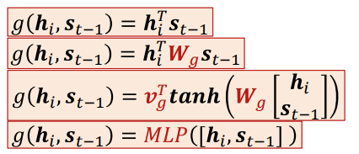
Attention weights
3
Ich habe einen
N
i
i
i
i
–1
0
1
2
i
Sum to 1.0
–1
0
1
2
3
4
<sos> Ich habe einen
(variables in red must learned)
I ate an
apple <eos>
Typical options for
i
i
t–1
i
i
j
j
KAUST Academy
Natural Language Processing
36

Slide 37
Attention weights
3
Ich habe einen
N
i
i
i
i
–1
0
1
2
i
Sum to 1.0
–1
0
1
2
3
4
Let’s consider a typica onversion process
l c
<sos> Ich habe einen
ate an apple <eos>
I
assuming this model as an example
Typical options for
(variables in red must learned)
i
i
t–1
i
i
j
j
KAUST Academy
Natural Language Processing
37

Slide 38
Converting an input: Inference
–1
0
1
2
3
4
I ate an
apple <eos>
•
Pass the input through the encoder to
produce hidden representations
KAUST Academy
Natural Language Processing
38

Slide 39


Converting an input: Inference
This may be
a learned parameter, or
Or just set to some fixed value,
e.g. a vector of 1s or 0s, or
Or the average of all the encoder
–1
embeddings:
0
4
where
Or
init 0 4
_{init} is a learned parameter
–1
0
1
2
3
4
I ate an
apple <eos>
•
Pass the input through the encoder to
produce hidden representations
KAUST Academy
Natural Language Processing
39

Slide 40





Converting an input: Inference
N
0
0
i
i
i
–1
–1
0
1
2
3
4
<sos>
I ate an
apple <eos>
Compute the attention weights 𝑤_{i} 0 for the first output using 𝑠_{–1}
  Will be a distribution over the input words
Compute “context” 𝑐₀
  Weighted sum of input word hidden states
Input 𝑐₀ and <sos> to the decoder at time 0
i –1
T
i g –1
i –1
i
i
<sos> because we are starting a new sequence
In practice we will enter the embedding of <sos>
i
j
j
39
KAUST Academy
Natural Language Processing
40

Slide 41

Converting an input: Inference
N
ich 0
du 0
hat 0
0
0
i
i
i
0
–1
0
0
–1
0
1
2
3
4
<sos>
I ate an
apple <eos>
The decoder computes
T
i –1 i g –1
–
i i –1
A probability distribution over the output vocabulary
  Output of softmax output layer
i
i
j
j
40
KAUST Academy
Natural Language Processing
41

Slide 42
Converting an input: Inference
ich 0
du 0
hat 0
N
Ich
0
0
i
i
i
0
–1
0
0
–1
0
1
2
3
4
<sos>
I ate an
apple <eos>
Sample a word from the output distribution
i –1
T
i g –1
i –1
i
i
i
j
j
41
KAUST Academy
Natural Language Processing
42

Slide 43


Converting an input: Inference
1
Ich
0
–1
0
0
–1
0
1
2
3
4
<sos> Ich
I ate an
apple <eos>
Compute the attention weights 𝑤_{i} (1) over all inputs for the second output using 𝑠₀
  Compute raw weights, followed by softmax
Compute “context” 𝑐₁
  Weighted sum of input hidden representations
Input 𝑐₁ and first output word to the decoder
  In practice we enter the embedding of the word
T
i 0 i
g 0
i
i 0
N
i
i
1
i
i
j
j
i
42
KAUST Academy
Natural Language Processing
43

Slide 44
Converting an input: Inference
Ich
ich 1
du 1
hat 1
1
0
1
–1
0
1
0
1
–1
0
1
2
3
4
<sos> Ich
I ate an
apple <eos>
The decoder computes
T
i 0 i
g 0
–
i
i 0
1
N
– A probability distribution over the output vocabulary
i
i
1
i
i
j
j
i
KAUST Academy
Natural Language Processing
44

Slide 45
Converting an input: Inference
Ich habe
ich 1
du 1
hat 1
1
N
1
i
i
0
1
i
–1
0
1
0
1
–1
0
1
2
3
4
<sos> Ich
I ate an
apple <eos>
Sample the second word from the output distribution
T
i 0 i
g 0
i
i 0
N
i
i
1
i
i
j
j
i
KAUST Academy
Natural Language Processing
45

Slide 46

Converting an input: Inference
2
Ich habe
0
1
–1
0
1
0
1
–1
0
1
2
3
4
<sos>
Ich habe
I ate an
apple <eos>
T
i 1 i
g 1
i
i 1
N
i
i
2
i
i
j
j
i
45
KAUST Academy
Natural Language Processing
46

Slide 47
Converting an input: Inference
2
Ich habe
ich 2
du 2
hat 2
0
1
2
–1
0
1
2
0
1
2
–1
0
1
2
3
4
<sos>
Ich habe
I ate an
apple <eos>
T
i 1 i
g 1
i
i 1
N
i
i
2
i
i
j
j
i
46
KAUST Academy
Natural Language Processing
47

Slide 48
Converting an input: Inference
2
Ich habe einen
ich 2
du 2
hat 2
0
1
2
–1
0
1
2
0
1
2
–1
0
1
2
3
4
<sos>
Ich habe
I ate an
apple <eos>
T
i 1 i
g 1
i
i 1
N
i
i
2
i
i
j
j
i
47
KAUST Academy
Natural Language Processing
48

Slide 49


Converting an input: Inference
3
Ich habe einen
0
1
2
–1
0
1
2
0
1
2
–1
0
1
2
3
4
<sos>
Ich habe
einen
I ate an
apple <eos>
i
i
2
N
i
i
3
i
i
j
j
i
KAUST Academy
Natural Language Processing
49

Slide 50
Converting an input: Inference
3
Ich habe einen
ich 3
du 3
hat 3
0
1
2
3
–1
0
1
2
3
0
3
1
2
–1
0
1
2
3
4
<sos>
Ich habe
einen
I ate an
apple <eos>
i
i
2
N
i
i
3
i
i
j
j
i
KAUST Academy
Natural Language Processing
50

Slide 51
Converting an input: Inference
3
Ich habe einen apfel
ich 3
du 3
hat 3
0
1
2
3
–1
0
1
2
3
0
3
1
2
–1
0
1
2
3
4
<sos>
Ich habe
einen
I ate an
apple <eos>
i
i
2
N
i
i
3
i
i
j
j
i
50
KAUST Academy
Natural Language Processing
51

Slide 52


Converting an input: Inference
Ich habe einen apfel
4
0
1
2
3
-1
0
1
2
3
–1
0
1
2
3
4
 |  | 0 |  |  | 1 |  |  | 2 |  |  | 3
–1 |  | 0 |  |  | 1 |  |  | 2 |  |  | 3
 | 0 |  | 1 |  |  | 2 |  |  | 3
<sos>
Ich habe
einen
apfel
I ate an
apple <eos>
i
i 3
N
i
i
4
i
i
j
j
i
51
KAUST Academy
Natural Language Processing
52

Slide 53

Converting an input: Inference
ich 4
du 4
hat 4
Ich habe einen apfel
4
 |  | 0 |  | 1 |  | 2 |  | 3 |  | 4
–1 |  | 0 |  | 1 |  | 2 |  | 3 |  | 4
4
0
1
2
3
–1
0
1
2
3
4
<sos>
Ich habe
einen
apfel
I ate an
apple <eos>
i
i
3
N
i
i
4
i
i
j
j
i
KAUST Academy
Natural Language Processing
53

Slide 54
Converting an input: Inference
ich 4
du 4
hat 4
Ich habe einen apfel gegessen
4
 |  | 0 |  | 1 |  | 2 |  | 3 |  | 4
–1 |  | 0 |  | 1 |  | 2 |  | 3 |  | 4
4
0
1
2
3
–1
0
1
2
3
4
<sos>
Ich habe
einen
apfel
I ate an
apple <eos>
i
i
3
N
i
i
4
i
i
j
j
i
KAUST Academy
Natural Language Processing
54

Slide 55

Converting an input: Inference
Ich habe einen apfel gegessen
5
0
1
2
3
4
-1
0
1
2
3
4
–1
0
1
2
3
4
<sos>
Ich habe
einen
apfel
gegessen
I ate an
apple <eos>
i
i 4
N
i
i
5
i
i
j
j
i
54
KAUST Academy
Natural Language Processing
55

Slide 56
Converting an input: Inference
ich 5
Ich habe einen apfel gegessen
du 5
5
 |  | 0 |  | 1 |  | 2 |  | 3 |  | 4 |  | 5
–1 |  | 0 |  | 1 |  | 2 |  | 3 |  | 4 |  | 5
hat 5
5
0
1
2
3
4
–1
0
1
2
3
4
<sos>
Ich habe
einen
apfel
gegessen
I ate an
apple <eos>
i
i 4
N
i
i
5
i
i
j
j
i
55
KAUST Academy
Natural Language Processing
56

Slide 57
Converting an input: Inference
ich 5
Ich habe einen apfel gegessen <eos
>
du 5
5
 |  | 0 |  | 1 |  | 2 |  | 3 |  | 4 |  | 5
–1 |  | 0 |  | 1 |  | 2 |  | 3 |  | 4 |  | 5
hat 5
5
0
1
2
3
4
–1
0
1
2
3
4
<sos>
Ich habe
einen
apfel
gegessen
I ate an
apple <eos>
Continue this process until
<eos> is drawn
i
i 4
N
i
i
5
i
i
j
j
i
56
KAUST Academy
Natural Language Processing
57

Slide 58

Attention-based decoding
Ich habe einen apfel gegessen <eos>
2 3 4 5
0
1
–1
0
1
2
3
4
5
–1
0
1
2
3
4
I ate an
apple <eos>
<sos>
Ich habe
einen
apfel
gegessen
i
i t–1
N
i
t
i
i
i
i
j
j
57
KAUST Academy
Natural Language Processing
58

Slide 59

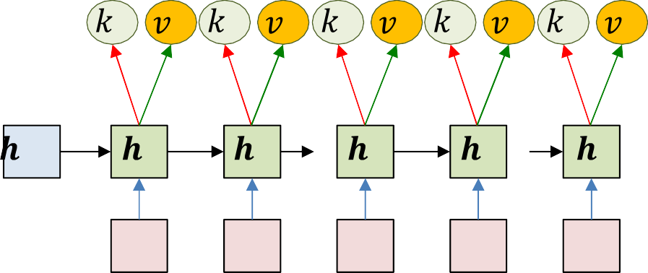

Modification: Query key value
j q j–1
Ich habe
0
1
2
–1
0
1
0
0
1
1
2
2
3
3
4
4
<sos>
Ich
–1
0
1
2
3
4
i | k | i
i | v | i
I
ate
an
apple
<eos>
•
Encoder outputs an explicit “key” and “value” at each input time
–
Key is used to evaluate the importance of the input at that time, for a given output
•
Decoder outputs an explicit “query” at each output time
–
Query is used to evaluate which inputs to pay attention to
•
•
The weight is a function of key and query
The actual context is a weighted sum of value
KAUST Academy
Natural Language Processing
59

Slide 60


Modification: Query key value
i i t
i q i–1
Ich habe
i i
0
1
2
Input to hidden decoder
layer:
i i i
–1
0
1
0
0
1
1
2
2
3
3
4
4
<sos>
Ich
–1
0
1
2
3
4
i | k | i
i | v | i
I
ate
an
apple
<eos>
•
Encoder outputs an explicit “key” and “value” at each input time
–
Key is used to evaluate the importance of the input at that time, for a given output
•
Decoder outputs an explicit “query” at each output time
–
Query is used to evaluate which inputs to pay attention to
•
•
The weight is a function of key and query
The actual context is a weighted sum of value
KAUST Academy
Natural Language Processing
60

Slide 61



Modification: Query key value
i i t
Ich habe
i i
0
1
2
Input to hidden decoder
layer:
i i i
–1
0
1
0
0
1
1
2
2
3
3
4
4
<sos>
Ich
–1
0
1
2
3
4
I ate an
apple <eos>
Special case:
• Encoder outputs an explicit “key” and “value” at each input time
– Key is used to evaluate the importance of the input at that time, for a given output
• Decoder outputs an explicit “query” at each output time
– Query is used to evaluate which inputs to pay attention to
• The weight is a function of key and query
• The actual context is a weighted sum of value ⁶⁰
KAUST Academy
Natural Language Processing
61

Slide 62
Pseudocode
# Assuming encoded input
# (K,V) = [k_{enc}[0]… k_{enc}[T]], [v_{enc}[0]… v_{enc}[T]]
# is available
t = -1
h_{out}[-1] = 0
q[0] = 0
# Initial Decoder hidden state # Initial query
# Note: begins with a “start of sentence” symbol # <sos> and <eos> may be identical
Y_{out}[0] = <sos> do
t = t+1
C = compute_context_with_attention(q[t], K, V) y[t],h_{out}[t],q[t+1] = RNN_decode_step(h_{out}[t-1], y_{out}[t-1], C) y_{out}[t] = generate(y[t]) # Random, or greedy
until y_{out}[t] == <eos>
KAUST Academy
Natural Language Processing
62

Slide 63
Pseudocode : Computing context with attention
# Takes in previous state, encoder states, outputs attention-weighted context
function compute_context_with_attention(q, K, V) # First compute attention
e = []
for t = 1:T # Length of input
e[t] = raw_attention(q, K[t])
end
maxe = max(e) # subtract max(e) from everything to prevent underflow a[1..T] = exp(e[1..T] - maxe) # Component-wise exponentiation
suma = sum(a) # Add all elements of a a[1..T] = a[1..T]/suma
C = 0
for t = 1..T
C += a[t] * V[t]
end
return C
KAUST Academy
Natural Language Processing
63

Slide 64
habe
Ich
einen apfel gegessen <eos>
2 3 4 5
0
1
–1
0
1
2
3
4
5
0
<sos> Ich
habe einen
apfel
gegessen
1
2
3
4
5
–1
0
1
2
3
4
I ate an
apple <eos>
As before, the objective of drawing: Produce the most likely output (that ends in an <eos>)
argmax 𝑦⁰¹ 𝑦⁰² … 𝑦^{0L}
0₁,…,0_{L}
1 1 1
Simply selecting the most likely symbol at each time may result in suboptimal output
KAUST Academy
Natural Language Processing
64

Slide 65


Solution: Multiple choices
I
He
<sos>
We
The
Retain all choices and fork the network
– With every possible word as input
KAUST Academy
Natural Language Processing
65

Slide 66

To prevent blowup: Prune
I
He
K
1 1
N
We
The
Prune
– At each time, retain only the top K scoring forks
KAUST Academy
Natural Language Processing
66

Slide 67

Decoding
He
The
•
At each time, retain only the top K scoring forks
KAUST Academy
Natural Language Processing
67

Slide 68
Decoding
I
Note: based on product
Knows
He
K
2 1 1
N
…
K
2 1 1
N
1 1
N
I
The
Nose
…
•
At each time, retain only the top K scoring forks
KAUST Academy
Natural Language Processing
68

Slide 69
Decoding
I
Note: based on product
Knows
He
K
2 1 1
N
…
K
2 1 1
N
1 1
N
I
The
Nose
…
•
At each time, retain only the top K scoring forks
KAUST Academy
Natural Language Processing
69

Slide 70
Decoding
Knows
2 1 1
2 1 1
N
N
He
K
…
1 1
N
The
Nose
•
At each time, retain only the top K scoring forks
KAUST Academy
Natural Language Processing
70

Slide 71
Decoding
Knows
2 1 1
2 1 1
N
N
He
K
…
1 1
N
The
Nose
•
At each time, retain only the top K scoring forks
70
KAUST Academy
Natural Language Processing
71

Slide 72
Decoding
Knows
He
n
K
n 1
n–1 1
N
t=1
The
Nose
•
At each time, retain only the top K scoring forks
71
KAUST Academy
Natural Language Processing
72

Slide 73
Terminate
Knows
He
<eos>
The
Nose
Terminate
  When the current most likely path overall ends in <eos>
    Or continue producing more outputs (each of which terminates in <eos>) to get N-best outputs
72
KAUST Academy
Natural Language Processing
73

Slide 74
Termination: <eos>
Example has K = 2
<eos>
Knows
He
<eos>
<eos>
The
Nose
Terminate
  Paths cannot continue once the output an <eos>
    So paths may be different lengths
– Select the most likely sequence ending in <eos> across all terminating sequences
73
KAUST Academy
Natural Language Processing
74

Slide 75
Pseudocode: Beam search
# Assuming encoder | output H = | h_{in}[1]… h_{in}[T] is available
path = <sos> beam = {path} pathscore = [path] | = 1
state[path] = h[0] | # initial | state (computed using your favorite method)
do # Step forward nextbeam = {} nextpathscore = [] nextstate = {} for path in beam:
cfin = path[end] hpath = state[path]
C = compute_context_with_attention(hpath, H) y,h = RNN_decode_step(hpath, cfin, C)
for c in Symbolset newpath = path + c nextstate[newpath] = h
nextpathscore[newpath] = pathscore[path]*y[c] nextbeam += newpath # Set addition
end
end
beam, pathscore, state, bestpath = prune(nextstate,nextpathscore,nextbeam) until bestpath[end] = <eos>
KAUST Academy
Natural Language Processing
75

Slide 76
Pseudocode: Beam search
# Assuming encoder output H = h_{in}[1]… h_{in}[T] is available path = <sos>
beam = {path} pathscore = [path] = 1
state[path] = h[0] # computed using your favorite method context[path] = compute_context_with_attention(h[0], H)
do # Step forward nextbeam = {} nextpathscore = [] nextstate = {} nextcontext = {} for path in beam:
cfin = path[end] hpath = state[path] C = context[path]
y,h = RNN_decode_step(hpath, cfin, C)
Slightly more efficient.
Does not perform redundant context computation
nextC = compute_context_with_attention(h, H) for c in Symbolset
newpath = path + c nextstate[newpath] = h nextcontext[newpath] = nextC
nextpathscore[newpath] = pathscore[path]*y[c] nextbeam += newpath # Set addition
end
end
beam, pathscore, state, context, bestpath =
prune (nextstate, nextpathscore, nextbeam, nextcontext)
until bestpath[end] = <eos>
KAUST Academy
Natural Language Processing
76

Slide 77





What does the attention learn?
Ich
0 1
1
i
i
i
–1
0
1
0
T
i 0 i
g 0
<sos> Ich
–1
0
1
2
3
4
I ate an
apple <eos>
The key component of this model is the attention weight
– It captures the relative importance of each position in the input
to the current output
76
KAUST Academy
Natural Language Processing
77

Slide 78
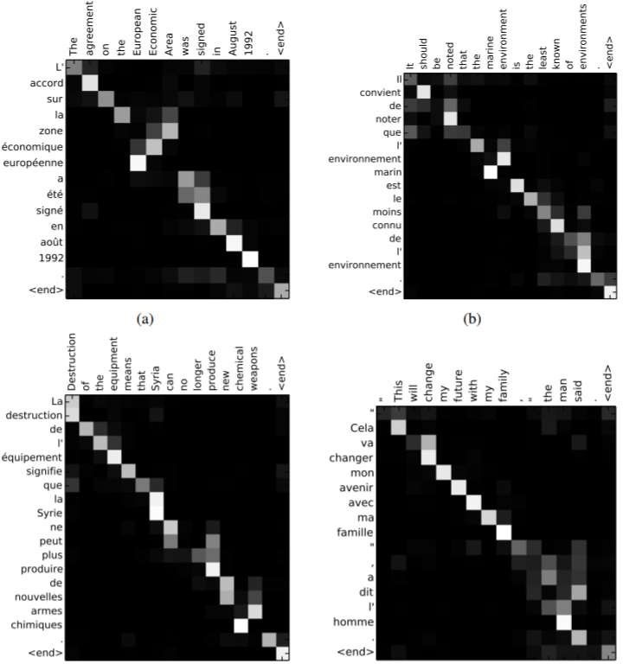

“Alignments” example: Bahdanau et al.
Plot of
𝒊
Color shows value (white is larger)
Note how most important input words for any output word get automatically highlighted
t
The general trend is somewhat linear because word order is roughly similar in both languages
t
i
i
77
KAUST Academy
Natural Language Processing
78

Slide 79
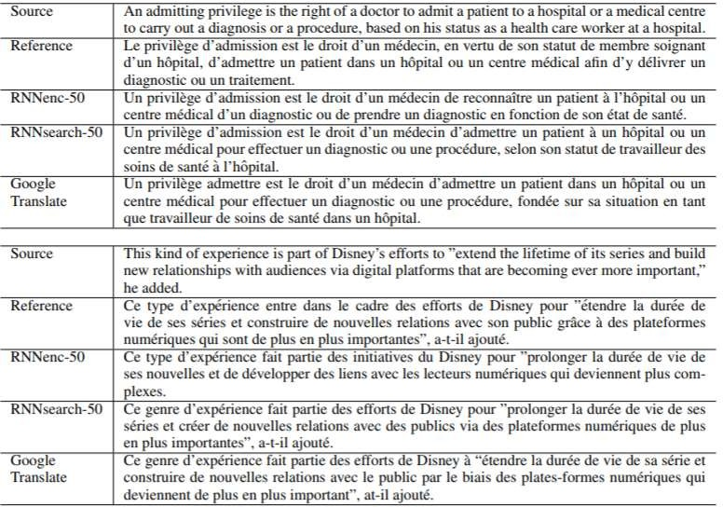
Translation Examples
Bahdanau et al. 2016
KAUST Academy
Natural Language Processing
79

Slide 80
Training the network
We have seen how a trained network can be used to compute outputs
– Convert one sequence to another
Let’s consider training..
KAUST Academy
Natural Language Processing
80

Slide 81
_{𝑦}ich 0
_{𝑦}du 0
_{𝑦}hat 0
…
_{𝑦}ich 1
_{𝑦}du 1
_{𝑦}hat 1
…
_{𝑦}ich 2
_{𝑦}du 2
_{𝑦}hat 2
…
_{𝑦}ich 3
_{𝑦}du 3
_{𝑦}hat 3
…
_{𝑦}ich 4
_{𝑦}du 4
_{𝑦}hat 4
…
_{𝑦}ich 5
_{𝑦}du 5
_{𝑦}hat 5
…
–1
0
1
2
3
4
5
<sos> Ich habe
einen
apfel
gegessen
–1
0
1
2
3
4
I ate an
apple <eos>
Given training input (source sequence, target sequence) pairs
Forward pass: Pass the actual input sequence through the encoder
– At each time the output is a probability distribution over words
80
KAUST Academy
Natural Language Processing
81

Slide 82
Ich habe einen apfel gegessen<eos>
Div
Div
Div
Div
Div
Div
_{𝑦}ich 0
_{𝑦}du 0
_{𝑦}hat 0
…
_{𝑦}ich 1
_{𝑦}du 1
_{𝑦}hat 1
…
_{𝑦}ich 2
_{𝑦}du 2
_{𝑦}hat 2
…
_{𝑦}ich 3
_{𝑦}du 3
_{𝑦}hat 3
…
_{𝑦}ich 4
_{𝑦}du 4
_{𝑦}hat 4
…
_{𝑦}ich 5
_{𝑦}du 5
_{𝑦}hat 5
…
–1
0
1
2
3
4
5
<sos> Ich habe
einen
apfel
gegessen
–1
0
1
2
3
4
I
ate
an
apple <eos>
•
Backward pass:
Compute a divergence between target
output and output distributions
– Backpropagate derivatives through the network
KAUST Academy
Natural Language Processing
82

Slide 83

Ich habe einen apfel gegessen<eos>
Div
Div
Div
Div
Div
Div
_{𝑦}ich 0
_{𝑦}du 0
_{𝑦}hat 0
…
_{𝑦}ich 1
_{𝑦}du 1
_{𝑦}hat 1
…
_{𝑦}ich 2
_{𝑦}du 2
_{𝑦}hat 2
…
_{𝑦}ich 3
_{𝑦}du 3
_{𝑦}hat 3
…
_{𝑦}ich 4
_{𝑦}du 4
_{𝑦}hat 4
…
_{𝑦}ich 5
_{𝑦}du 5
_{𝑦}hat 5
…
Back propagation also updates parameters of the “attention” function
–1
0
1
2
3
4
5
<sos> Ich habe
einen
apfel
gegessen
–1
0
1
2
3
4
I
ate
an
apple <eos>
•
Backward pass:
Compute a divergence between target
output and output distributions
– Backpropagate derivatives through the network
KAUST Academy
Natural Language Processing
83

Slide 84

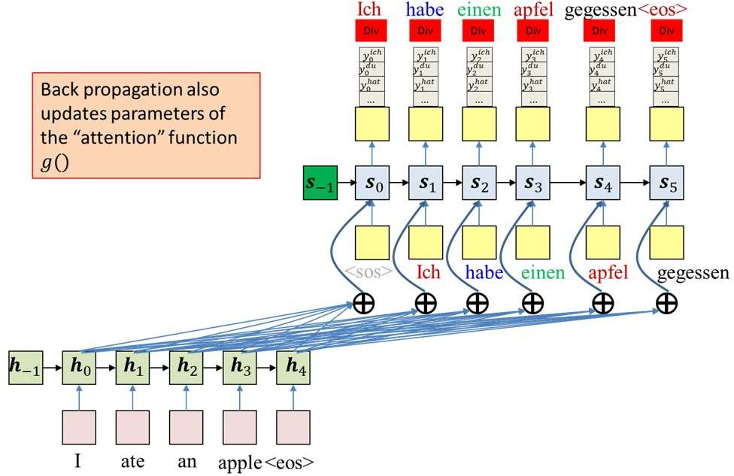




Training Paradigms
Target
Loss
1 2 3 4 5 6
Decoder takes in ground truth labels for inference
output
Complicated Neural Network Model
This approach, in fact, performs maximum-likelihood estimation of the model
  The forward pass of training takes in both inputs and ground-truth output labels for generation
  This forward pass is not like regular inference
83
KAUST Academy
Natural Language Processing
84

Slide 85
Training Paradigms
Target
Loss
1 2 3 4 5 6
Decoder takes in ground truth labels for inference
output
Complicated Neural Network Model
This approach, in fact, performs maximum-likelihood estimation of the model
  The forward pass of training takes in both inputs and ground-truth output labels for generation
  This forward pass is not like regular inference
But there’s another more traditional mechanism for training
  Where the model only gets the input during the forward pass,
    The forward pass is identical to inference
  and the actual ground truth label is only used to compute loss…
84
KAUST Academy
Natural Language Processing
85

Slide 86

Training Paradigms
Target
Loss
1 2 3 4 5 6
output
Complicated Neural Network Model
Decoder does not see ground truth labels during inference
The traditional mechanism for training
– Why would this not work?
85
KAUST Academy
Natural Language Processing
86

Slide 87
Training Paradigms
Target
Loss
output
Goo na goo goo ha ha ha goo goo glug glug hilf mir <eos>
Complicated Neural Network Model
Decoder does not see ground truth labels during inference
The traditional mechanism for training
  Why would this not work?
The output could be anything
  And in the early stages of training, will be random
  Cannot really compute a loss
86
KAUST Academy
Natural Language Processing
87

Slide 88
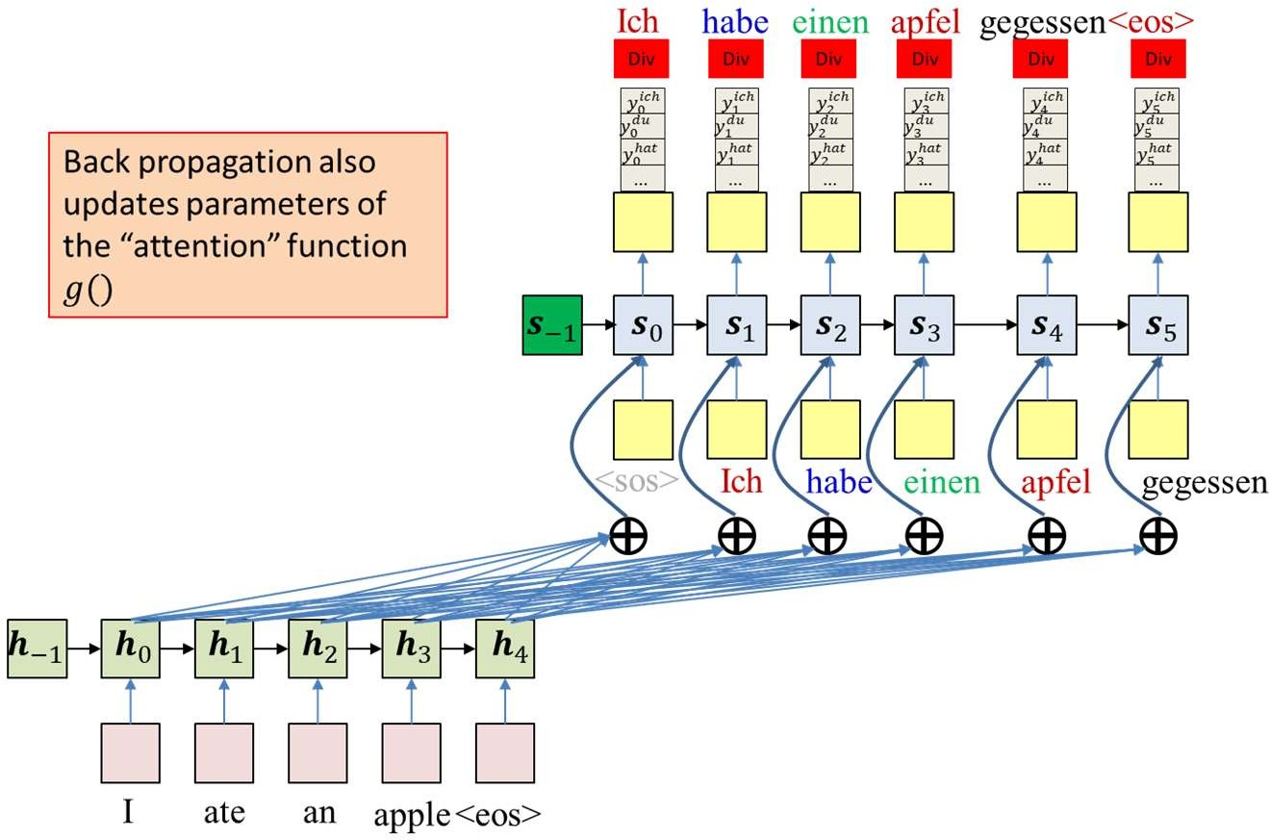
Training Paradigms
Decoder takes in ground truth labels for inference
The maximum-likelihood approach ensures a one-to-one correspondence between outputs and target outputs
But from the perspective of traditional training, it is “cheating” during the inference of the forward pass, where the ground truth is being passed in instead of drawn samples
  “Teacher forcing”
  Is there a midway solution?
Use drawn words during the forward pass inference while maintaining one-to-one correspondence
87
KAUST Academy
Natural Language Processing
88

Slide 89
The mid-way solution
Ich habe einen apfel gegessen<eos>
Div
Div
Div
Div
Div
Div
Use the ground truth during forward pass inference, but occasionally pass drawn output instead of ground truth, as input
_{𝑦}ich 0
_{𝑦}du 0
hat 𝑦₀
…
_{𝑦}ich 1
_{𝑦}du 1
hat 𝑦₁
…
 | _{𝑦}ich 2
 | _{𝑦}du 2
 | hat 𝑦₂
 | …
ein
 | _{𝑦}ich 3
 | _{𝑦}du 3
 | hat 𝑦₃
 | …
_{𝑦}ich 4
_{𝑦}du 4
hat 𝑦₄
…
_{𝑦}ich 5
_{𝑦}du 5
hat 𝑦₅
…
–1
0
1
2
3
4
5
<sos> Ich habe
***
apfel
gegessen
–1
0
1
2
3
4
I ate an
apple <eos>
Backward pass: Compute a divergence between target output and output distributions
– Backpropagate derivatives through the network
88
KAUST Academy
Natural Language Processing
89

Slide 90
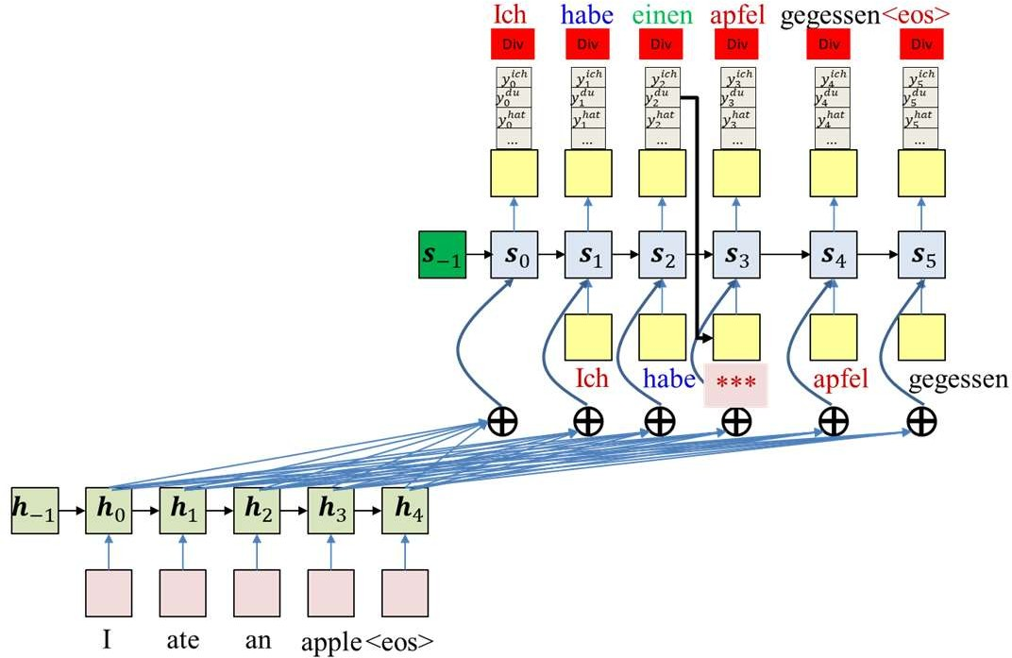



Gumbel Noise trick
Sampling is not differentiable
The “Gumbel noise” trick:
  “Reparametrization” :
𝑅𝑎𝑛𝑑𝑜𝑚𝑆𝑎𝑚𝑝𝑙𝑒 𝑌 = argmax(𝐺_{i} + log(𝑌))
i
  𝐺_{i} is drawn from the standard Gumbel distribution 𝐺𝑢𝑚𝑏𝑒𝑙(0,1)
The “argmax” can be replaced by a “softmax”, making the process differentiable w.r.t. network outputs
– 𝑑𝑒𝑐𝑜𝑑𝑒𝑟𝑜𝑢𝑡𝑝𝑢𝑡 𝑡 = 𝑠𝑜𝑓𝑡𝑚𝑎𝑥(𝐺_{i} + log(𝑌 𝑡 ))
∇_{F t} 𝑑𝑒𝑐𝑜𝑑𝑒𝑟𝑜𝑢𝑝𝑢𝑡(𝑡) is employed in the chain rule to pass derivatives from t+1 back to 𝑌(𝑡)
89
KAUST Academy
Natural Language Processing
90

Slide 91
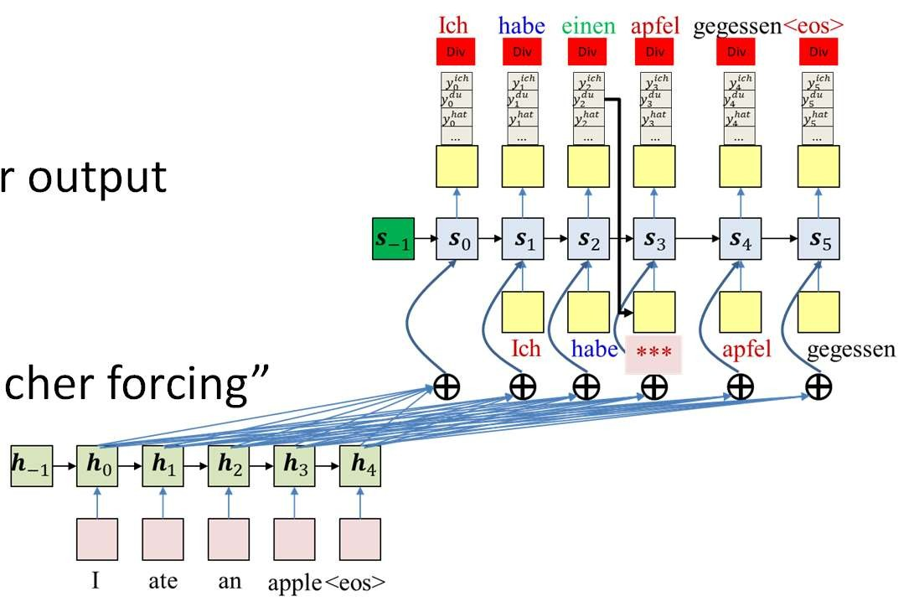
Tricks of the trade…
Teacher forcing:
  Ideally we would only use the decoder output during inference
  This will not be stable
  Passing in ground truth instead is “teacher forcing”
Sampling the output:
  Sample the system output and
  as input during training for only some of the time
The “Gumbel noise” trick:
  Sampling is not differentiable, and gradients cannot be passed through it
  The “Gumbel noise” approach recasts sampling as computing the argmax of a Gumbel distribution, with the network output as parameters
  The “argmax” can be replaced by a “softmax”, making the process differentiable w.r.t. network outputs
99
KAUST Academy
Natural Language Processing
91

Slide 92
Recap: Seq2Seq models
Ich habe
einen apfel
gegessen <eos>
I ate an
apple <eos> <sos>
Ich habe einen apfel gegessen
The input sequence feeds into a recurrent structure
The input sequence is terminated by an explicit <eos> symbol
– The hidden activation at the <eos> “stores” all information about the sentence
Subsequently a second RNN uses the hidden activation as initial state to produce a sequence of outputs
KAUST Academy
Natural Language Processing
92

Slide 93
Recap: Attention Models
Ich habe einen apfel gegessen <eos>
2 3 4 5
0
1
–1
0
1
2
3
4
5
–1
0
1
2
3
4
I ate an
apple <eos>
<sos> Ich habe einen apfel gegessen
Encoder recurrently produces hidden representations of input word sequence
Decoder recurrently generates output word sequence
– For each output word the decoder uses a weighted average of the hidden input representations as input “context”, along with the recurrent hidden state and the previous output word
KAUST Academy
Natural Language Processing
93

Slide 94
Recap: Attention Models
Ich habe einen apfel gegessen <eos>
2 3 4 5
0
1
–1
0
1
2
3
4
5
–1
0
1
2
3
4
I ate an
apple <eos>
<sos> Ich habe einen apfel gegessen
Problem: Because of the recurrence, the hidden representation for any word is also influenced by all preceding words
– The decoder is actually paying attention to the sequence, and not just the word
If the decoder is automatically figuring out which words of the input to attend to at each time, is recurrence in the input even necessary?
100
KAUST Academy
Natural Language Processing
94

Slide 95
Non-recurrent encoder
Ich habe einen apfel
2 3 4 5
gegessen <eos>
0
1
–1
0
1
2
3
4
5
0
1
2
3
4
I ate an
apple <eos>
<sos> Ich habe einen apfel gegessen
Modification: Let us eliminate the recurrence in the encoder
101
KAUST Academy
Natural Language Processing
95

Slide 96
Non-recurrent encoder
Ich habe einen apfel
2 3 4 5
gegessen <eos>
0
1
–1
0
1
2
3
4
5
0
1
2
3
4
I ate an
apple <eos>
<sos>
Ich habe
einen
apfel
gegessen
But this will eliminate context-specificity in the encoder embeddings
  The embedding for “an” must really depend on the remaining words
    It could be translated to “ein”, “einer”, or “eines” depending on the context.
Solution: Use the attention framework itself to introduce context- specificity in embeddings
KAUST Academy
Natural Language Processing
96

Slide 97
Recap: Non-recurrent encoder
Ich habe einen apfel gegessen <eos>
0 1 2 3 4 5
–1
0
1
2
3
4
5
0
1
2
3
4
I ate an
apple <eos>
<sos>
Ich habe
einen
apfel
gegessen
The encoder in a sequence-to-sequence model can be composed without recurrence.
Use the attention framework itself to introduce context-specificity in embeddings
– “Self” attention (We will study this in transformers)
KAUST Academy
Natural Language Processing
97

Slide 98

BLEU Score
BiLingual Evaluation Understudy
Compares candidate translations to reference (human) translations The closer to 1, the better
0
1

Slide 99
BLEU Score
Candidate | I | I | am | I
Reference 1 | Younes | said | I | am | hungry
Reference 2 | He | said | I | am | hungry
How many words from the candidate appear in the reference translations?

Slide 100



BLEU Score
Candidate | I | I |  | am |  | I
Reference 1 | Younes | said |  | I |  | am | hungry
Reference 2 | He | said |  | I |  | am | hungry
Count:
A model that always outputs common words will do great!

Slide 101

BLEU Score (Modified)
Candidate | I | I |  | am |  | I
Reference 1 | Younes | said |  |  |  |  | hungry
Reference 2 | He | said |  |  |  |  | hungry
I
I
am
am
Count:
Better than the previous implementation version!

Slide 102

BLEU score is great, but...
Consider the following:
BLEU doesn’t consider semantic meaning
BLEU doesn’t consider sentence structure:
“Ate I was hungry because!”

Slide 103

ROUGE
Recall-Oriented Understudy for Gisting Evaluation
Compares candidates with reference (human) translations Multiple versions for this metric

Slide 104
ROUGE-N
Candidate | I | I | am | I
Reference 1 | Younes | said | I | am | hungry
Reference 2 | He | said | I | am | hungry
How many words from the reference appear in the candidate translations?

Slide 105


ROUGE-N
Candidate | I |  | I |  |  | am |  |  | I
Reference 1 | Younes |  | said |  |  | I |  |  | am |  | hungry
Reference 2 | He |  | said |  |  | I |  |  | am |  | hungry
Count 1:
Count 2:

Slide 106
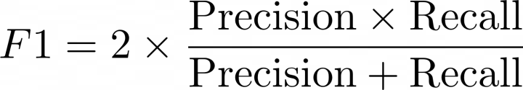
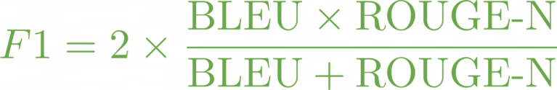
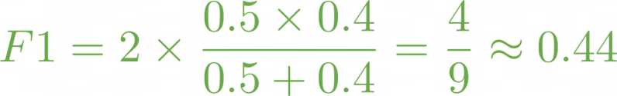
ROUGE-N, BLEU and F1 score
Candidate | I | I | am | I
Reference 1 | Younes | said | I | am | hungry
Reference 2 | He | said | I | am | hungry

Slide 107
References
These slides have been adapted from
Younes Mourri & Lukasz Kaiser, Natural Language Processcing Specialization, DeepLearning.Ai
Bhiksha Raj & Rita Singh, 11-785 Introduction to Deep Learning, CMU

